Slide 1
Higher Biology
Animal Welfare
Mr G R Davidson

Slide 2
Domesticated Animals
Animal welfare used to be based on the ability to resist disease, grow and reproduce successfully.
Improving conditions for domesticated animals is expensive.

Slide 3
Domesticated Animals
However, research has shown that improving the conditions for these animals results in more contented animals resulting in better growth, more successful reproduction and higher quality meat, eggs and milk.
It has also been shown that stressed animals show poorer growth.

Slide 4
Domesticated Animals
The obvious result of improving the conditions for these animals is that the end product becomes more expensive.
Since animal welfare in the UK is among the highest in the world, this makes British produce much more expensive than the imported produce.

Slide 5
Domesticated Animals
Human moral conduct raises some ethical questions in this area.
It is unethical to subject these animals to pain, distress and general negative experiences, e.g. battery hens kept in crowded conditions with their beaks trimmed to prevent them from harming each other just so that we can have cheaper eggs.

Slide 6
Poor Animal Welfare
When animals are kept in unnatural conditions, they often behave differently to animals in the wild.
These types of behaviour indicate poor animal welfare.

Slide 7
Poor Animal Welfare
Poor Welfare Behaviour | Example
Misdirected Behaviour | Over-grooming of feathers in chickens leading to damage of the feathers.
Stereotypy | Repetitive actions such as aimless chewing movements without having food, by pigs kept in pens which are too small.
Failure of reproductive behaviour | Rejection of offspring.
Abnormal activity | Hyper aggression in bulls.

Slide 8
Observing Behaviour
The study of animal behaviour is called ethology.
This provides information about normal behaviour patterns in their natural environment.

Slide 9
Observing Behaviour
From this information an ethogram can be constructed.
This can then be compared to domesticated animals.

Slide 10
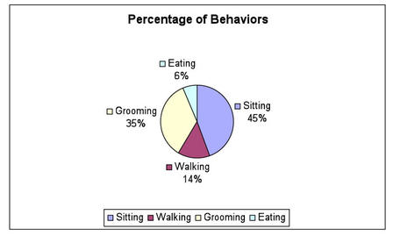
Ethogram
Example ethogram - Baboons

Slide 11
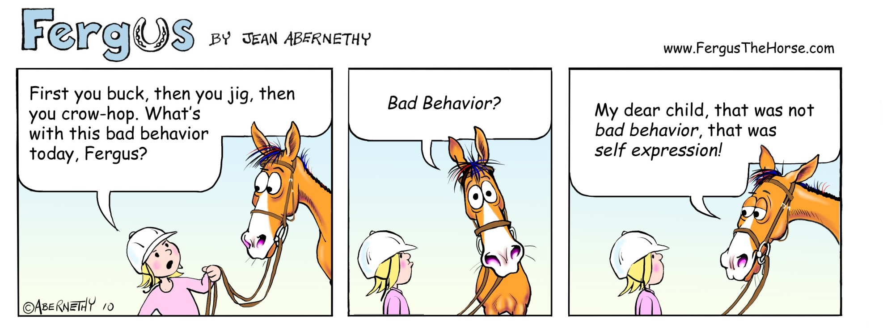
Ethogram

Slide 12
Preference Testing
We use preference tests to give animals a choice of conditions.
The animal is offered controlled choices, e.g. a choice chamber, radial arm maze, etc.

Slide 13
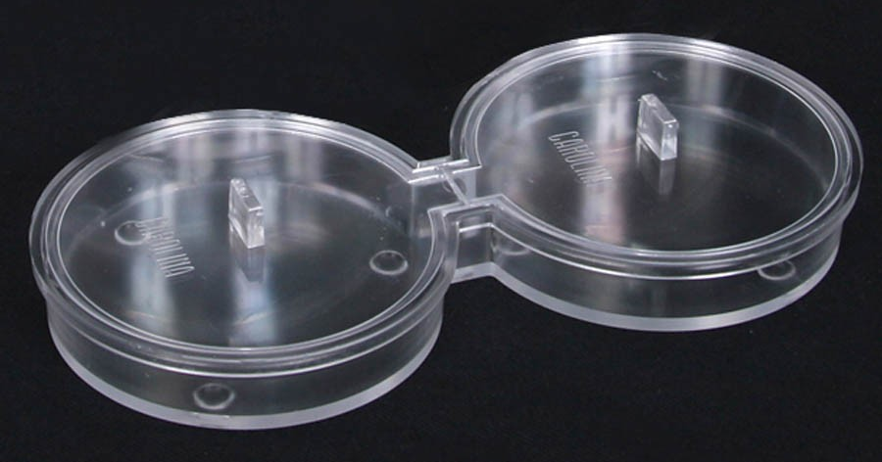
Choice Chamber

Slide 14
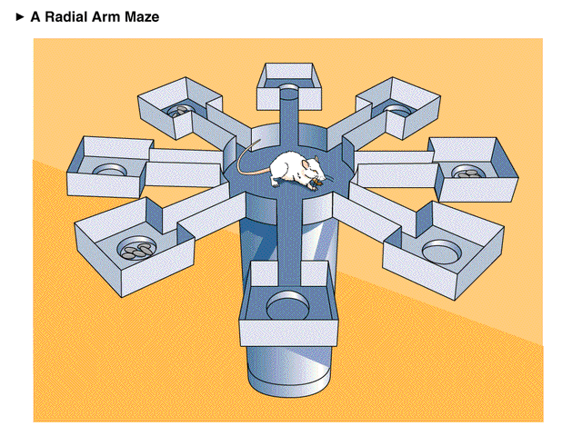
Radial Arm Maze

Slide 15
Motivation
All animals have basic needs which must be met if the animal is to survive, e.g.
Water
Food
Sleep

Slide 16
Motivation
Motivation is the desire to satisfy at least one of these needs.
If the animal has everything it needs it will lack motivation.
However, if the animal lacks at least one of the basic needs, it becomes motivated to seek it out.
The more deprived it becomes, the stronger the motivation.

Slide 17
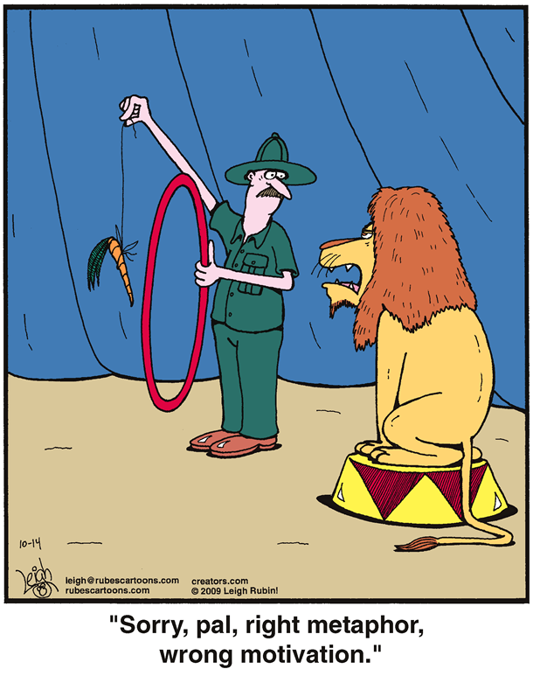
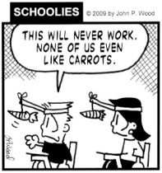
Motivation

Slide 18
Motivation
Preference tests can also be used to measure the strength of an animal’s motivation.
They can also be used to compare the motivation for 2 different behaviours, e.g.
Access to a sexually receptive mate or fresh drinking water.
Access to comfy bedding or the company of others.

Slide 19
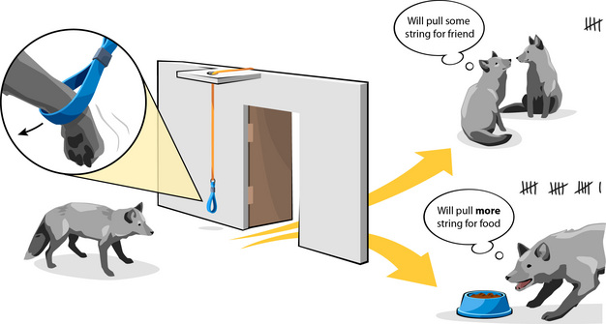
Motivation

